Slide 1

ASP .Net core- Entity Framework with
PostgreSQL
Notes:
<number>

Slide 2
Entity Framework Introduction
Entity Framework (EF) is an object-relational mapper that enables .NET developers to work with relational data using domain-specific objects. It eliminates the need for most of the data-access code that developers usually need to write.
The relational database schema is mapped to an object model
Visual Studio provides built-in tools for generating Entity Framework data models
Data mappings consist of C# classes, XML and attributes
EF provides a powerful data manipulation API
CRUD operations and complex querying with LINQ

Slide 3
Development Approaches with Entity Framework Core
There are two different approaches you can use while developing your application using Entity Framework:
1. Code-First
2. Database-First

Slide 4
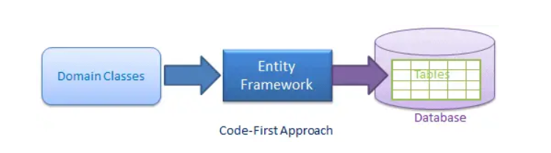
Code-First Approach
Use this approach when you do not have an existing database for your application. In the code-first approach, you start writing your entities (domain classes) and context class first and then create the database from these classes using migration commands.
Developers who follow the Domain-Driven Design (DDD) principles, prefer to begin with coding their domain classes first and then generate the database required to persist their data.
Learn more about this click here: code-first approch

Slide 5
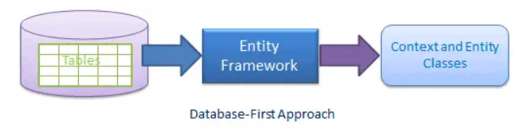
Database-First Approach
In the database-first development approach, you generate the context and entities for the existing database using Scaffold.
Learn more about this click here: database-first approch

Slide 6
Packages Required
Npgsql.EntityFrameworkCore.PostgreSQL
Microsoft.EntityFrameworkCore.Design
Microsoft.EntityFrameworkCore.Tools

Slide 7
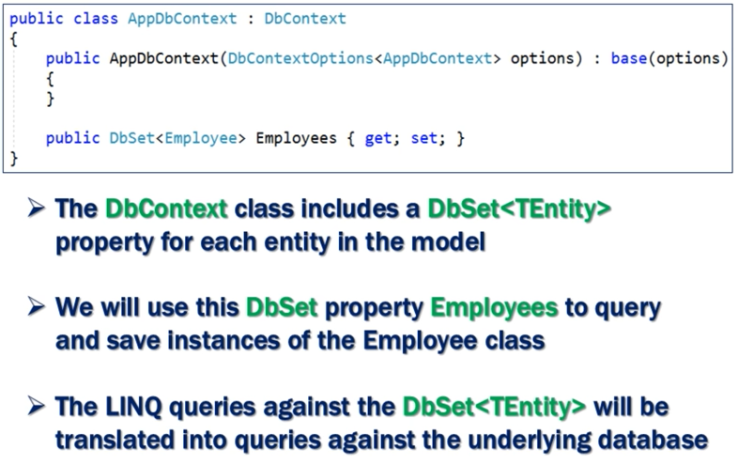
DbContext in EF Core

Slide 8
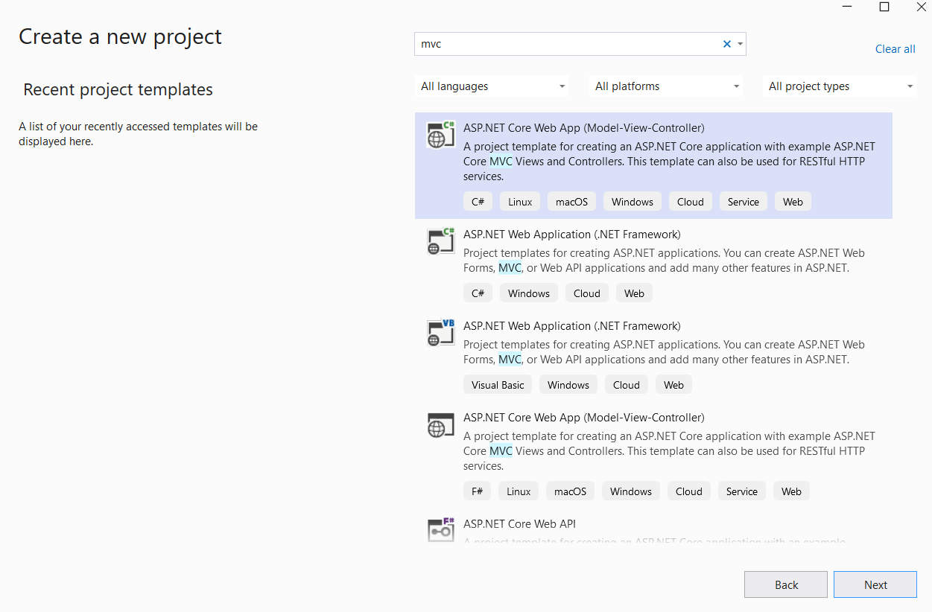
Setting Up the ASP.NET Core Project

Slide 9
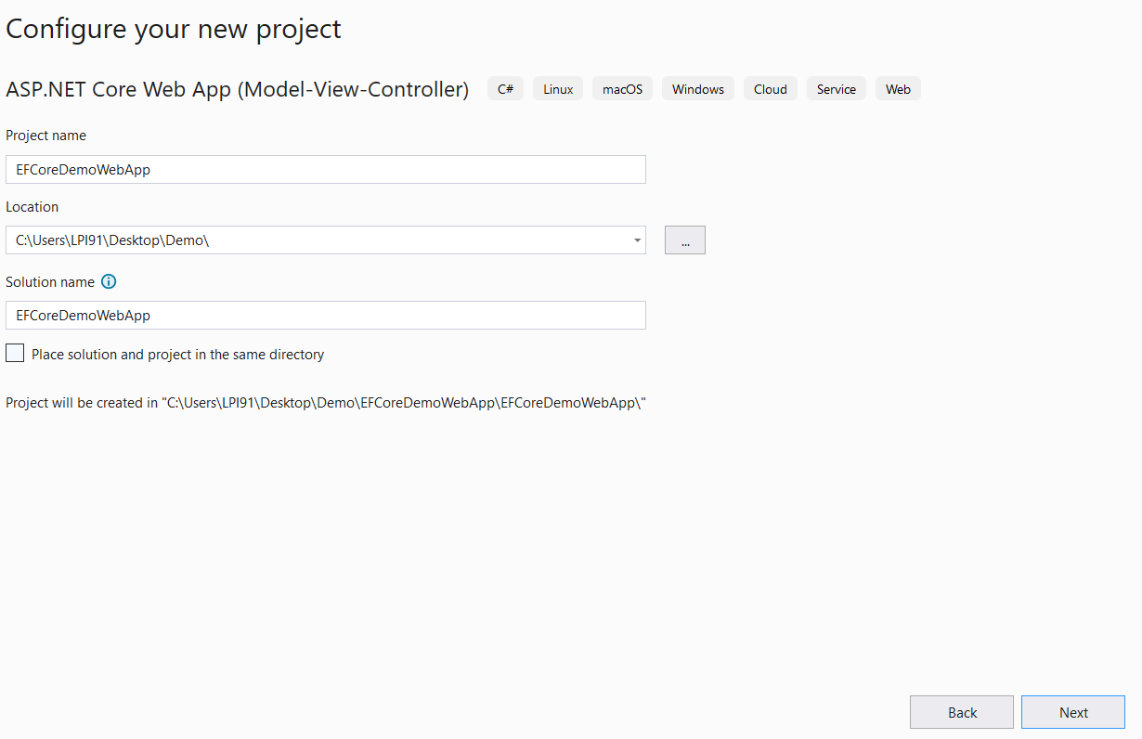

Slide 10
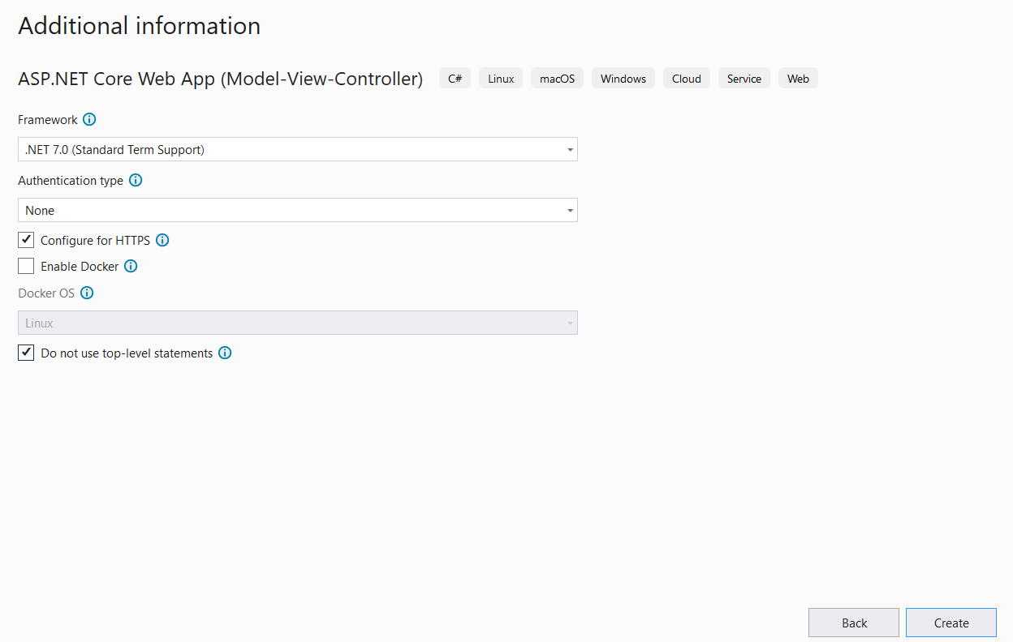

Slide 11
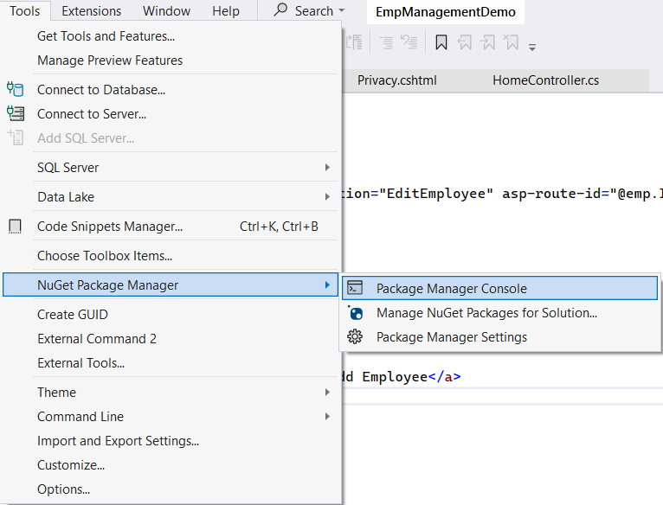
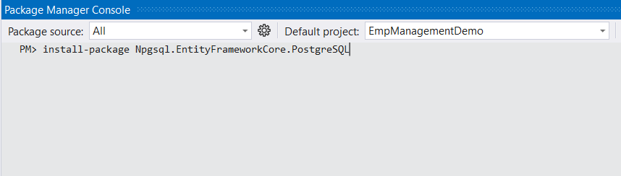
Install EF Core (PostgreSQL) using Package Manager Console

Slide 12
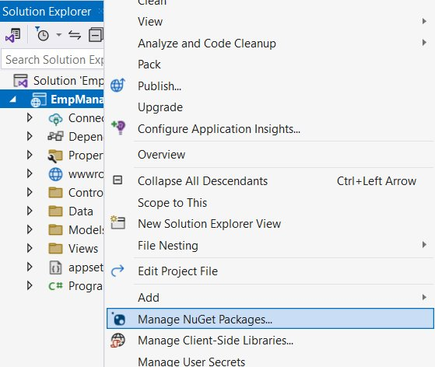
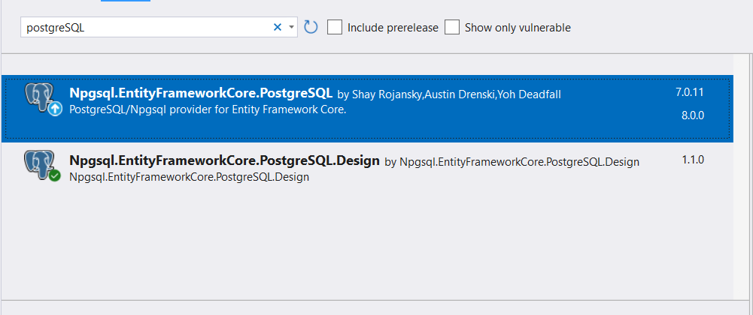
Install EF Core (PostgreSQL) using Nuget Packages for Solution

Slide 13
Structure Of Scaffold
Scaffold-DbContext [-Connection] [-Provider] [-OutputDir] [-Context] [-Schemas] [-Tables] [-DataAnnotations] [-Force] [-Project] [-StartupProject] [CommonParameters]
Connection – used to provide connection string
Provider – used to provide the Provider info
OutputDir – Generate model in specific folder
Context - provide name of our database context
contextDir - Generate dbcontext in specific folder
tables – generate models for specific tables
DataAnnotations – Generate models with data annotations
Force – forcedly updating the existing files

Slide 14
Example for Scaffold Command
Adding Connection String in Command
Scaffold-DbContext "User ID = postgres;Password=Tatva@123;Server=localhost;Port=5432;Database=EmployeeManagement;Integrated Security=true;Pooling=true;" Npgsql.EntityFrameworkCore.PostgreSQL -OutputDir "Models" –context "ApplicationDbContext" –contextDir "Data" -f;
Adding Connection String in Appsetting and using in command
Scaffold-DbContext –connection name=DefaultConnection Npgsql.EntityFrameworkCore.PostgreSQL -OutputDir Models –context ApplicationDBContext –contextDir Data -f

Slide 15
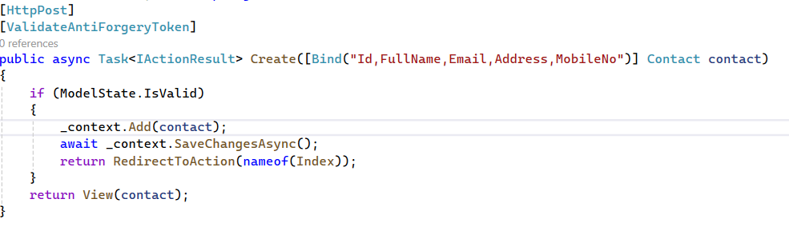
CRUD Operations With EF Core
Create Operation:

Slide 16
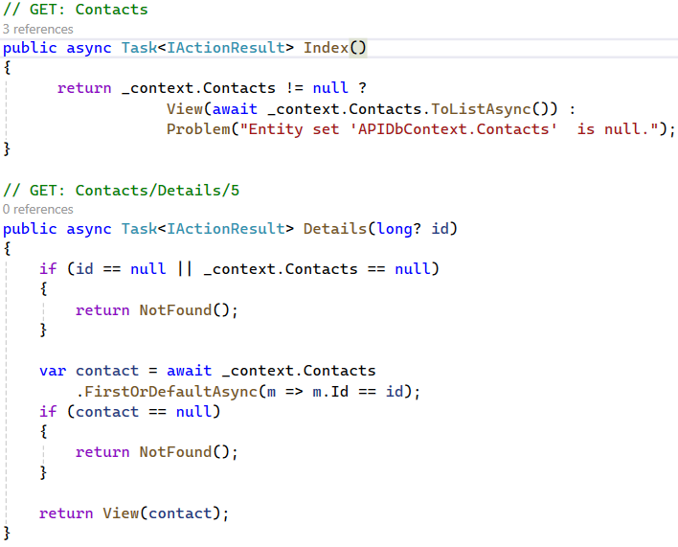
CRUD Operations With EF Core
Read Operation:

Slide 17
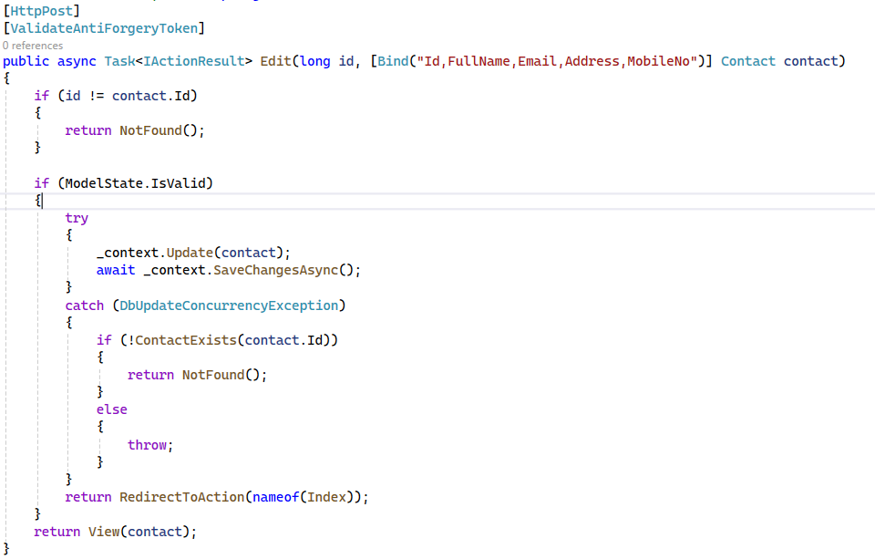
CRUD Operations With EF Core
Update Operation:

Slide 18
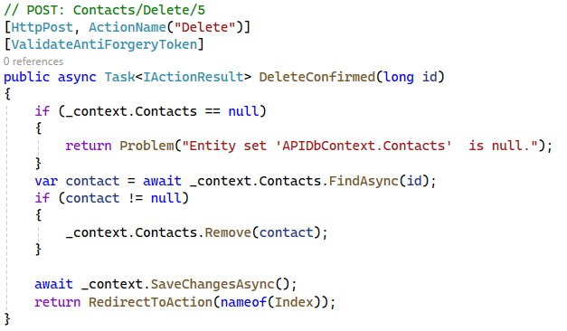
CRUD Operations With EF Core
Delete Operation:

Slide 19
Thank You
THANK YOU
ANY QUESTIONS ?
Notes:
<number>
<number>

